Slide 1
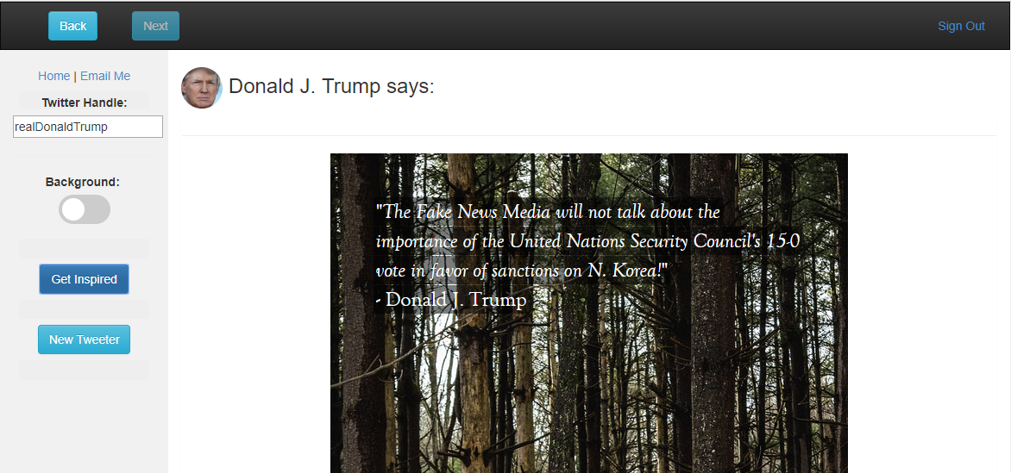
Inspire
CS602 Term Project
Justin Anderson
Inspirational (or otherwise) quotes straight from the mouths of thought-leaders today

Slide 2
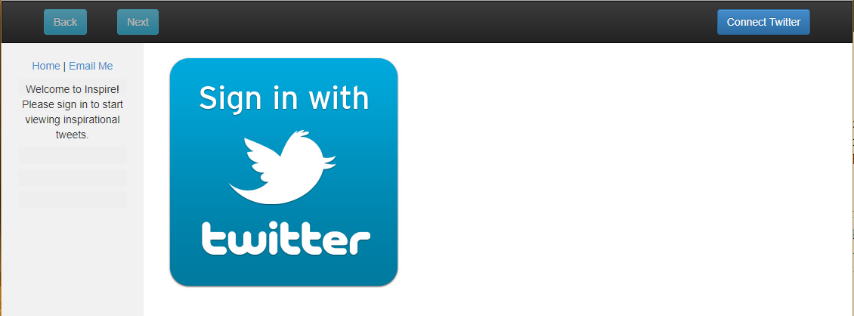
Layout - Login
Connect Here…
… Or Here

Slide 3
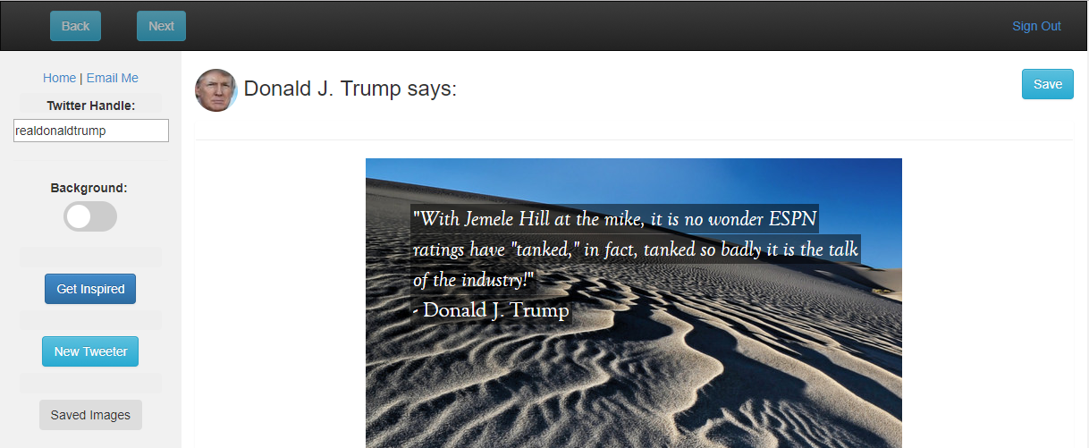
Layout - Main page
Navigate through Local Storage
(10 max)
Sign Out of Twitter
Dynamically loads Twitter User Info
Save Image and Tweet to MongoDB
Search Using Twitter Handle
Change Backgrounds
Pulls Next Tweet and Photo from Array
Random Quote and Image Pulled Every Time You Hit ‘Get Inspired’ or press enter with cursor in Input field
Search New Handle (or press enter with cursor in Input field)
Goes to Saved Images Page

Slide 4
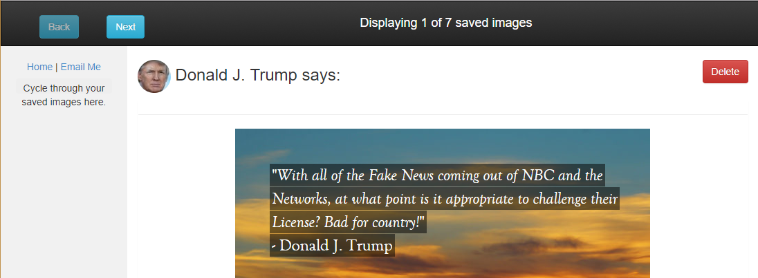
Layout - Saved images
Updates with total saved images
Cycle through images sent by the database
Deletes image from MongoDB and local array

Slide 5
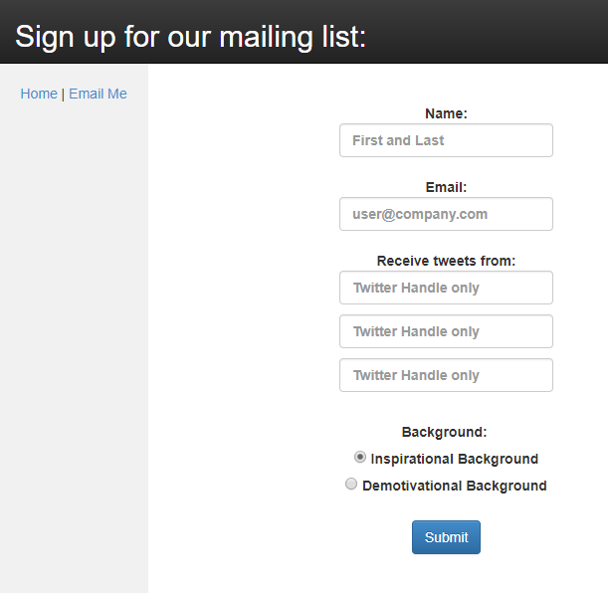
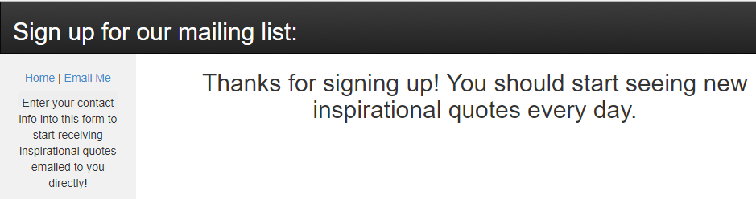
Layout - Form
Use this to sign up for a mailing list
Success – sends message below
Failure – replaces message with

Slide 6
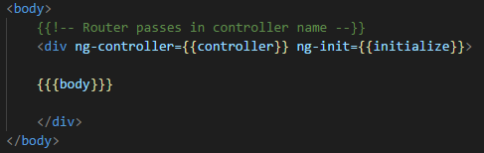

handlebars
File Structure
Public - serves static images, JavaScript, and stylesheets
Views - uses Node.JS/Handlebars routing to serve up pages
Passes in ng-controller and ng-init appropriate for served page
Data - hosts Flickr API dependency

Slide 7
Server Files
connectDb.js - runs outside the scope of the program to populate initial database entries
contactDb.js - builds two schemas and exports models when passed connection & name
twitterModule.js - hosts all server functions and connects to MongoDB
index.js - configures everything, sets up routes, hosts listener
credentials.js - export database login info

Slide 8
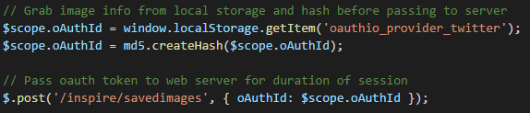
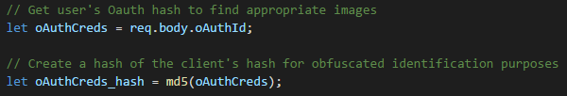
Encryption
Data flow
Client
MD5 hash
Sends MD5 hash instead of raw oAuth keys
Server
MD5 hash of MD5 hash
Uses hash as unique ID

Slide 9

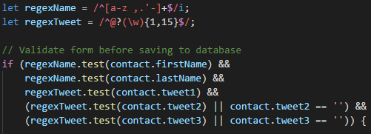
Form validation
Client
HTML 5 Validation - email
AngularJS Validation
Name
Tweets
Server
JavaScript validation
RegEx

Slide 10
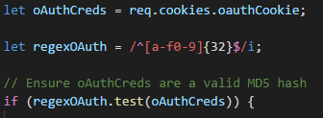
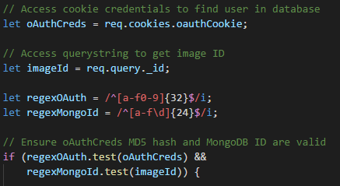
database access validation
oAuth hash
MongoDB ID

Slide 11
XSS Prevention
ngSanitize
Built-in AngularJS function which ensures no harmful HTML included
Used on values passed as HTML through ng-html-bind

Slide 12
http response
render - loads all pages while setting appropriate ng-controller/ng-init
json - sends saved images pulled from database
redirect - redirect to a new page when errors are generated, no context needed
set - modify response header value to prevent caching
cookie - sets cookie with twice-hashed oAuth credentials
send - after cookie is set, sends response

Slide 13
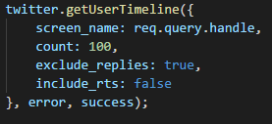
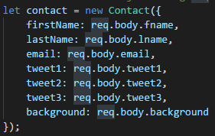
http request
GET
cookies - reads cookie attribute of request
query - looks at querystring for data
POST
body - sends data in POST body

Slide 14

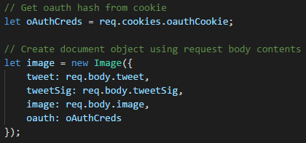
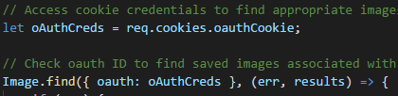
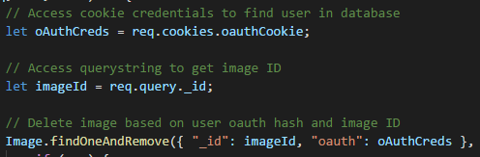

session persistence - Cookies
Session start
Stores oAuth hash in cookie to uniquely ID user based on oAuth keys
Uses cookie to
Stores unique ID in database with images
Delete appropriate image
Find images belonging to user

Slide 15
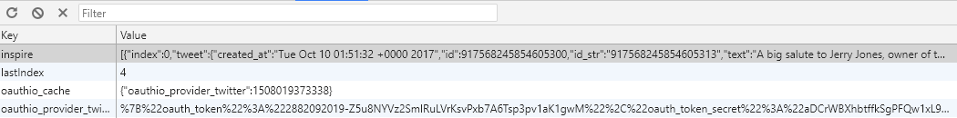
session persistence - local storage
Local Storage
Stores last 10 tweets
Last index retained to display last tweet upon page refresh
Allows user to cycle through previous tweets
Stores oAuth info so it doesn’t need to traverse the network after first login

Slide 16
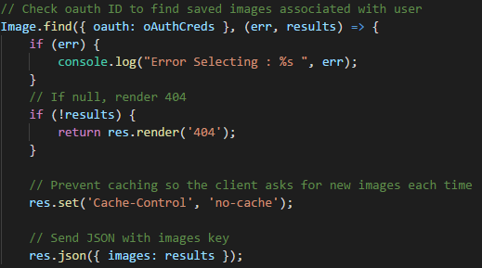
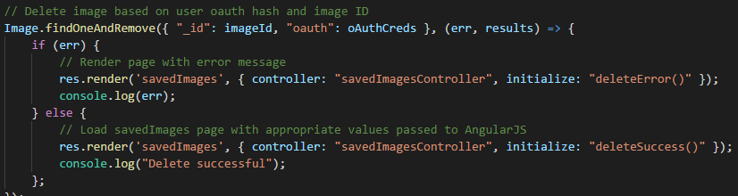
Permanent persistence - mongodb
MongoDB with Mongoose
find - returns all images belonging to user
findOneAndRemove - delete image based on ID sent by client and user in cookie
save - multiple schemas allows saving different types of objects
Image - 6 fields, 2 objects, 2 strings
Contact - 9 fields, 6 strings

Slide 17
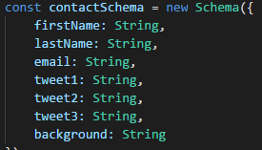
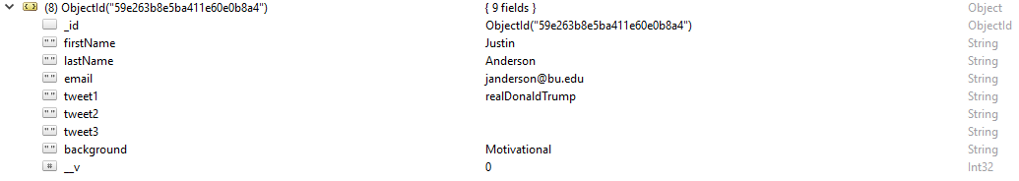

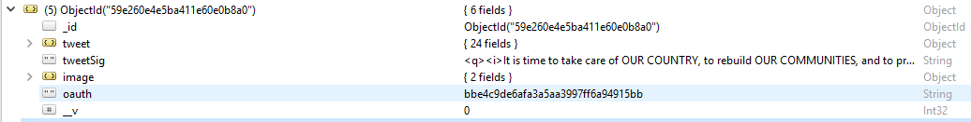
Permanent persistence - mongodb cont…
Contact
Image

Slide 18


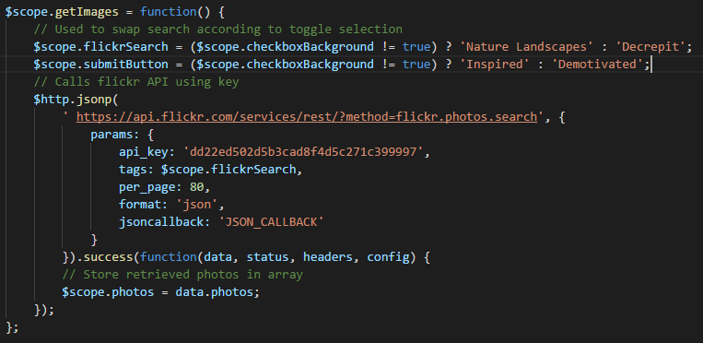
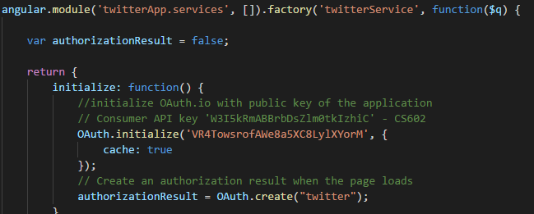
main application APIs
Flickr and Twitter APIs
Hosted and called by client for performance reasons

Slide 19
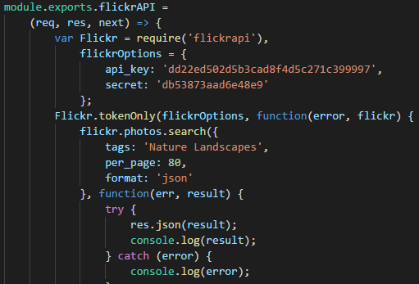
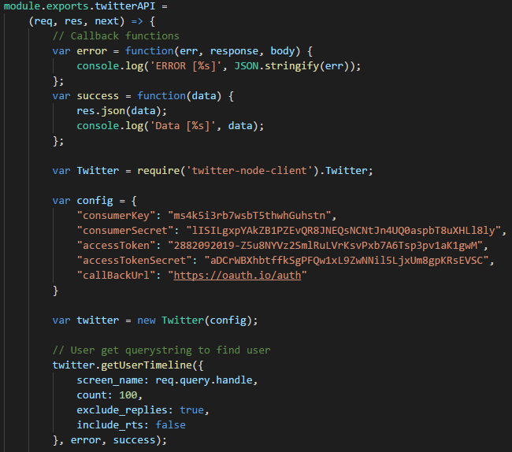
REStful APIs
Twitter
Can be called to return 100 tweets
Handle modified through querystring
curl -X GET -H "Content-Type: application/json" http://127.0.0.1:3000/inspire/api/twitter?handle=realdonaldtrump
Flickr
Can be called to return 80 image objects
Uses pre-set ‘Nature Landscapes’ tag
curl -X GET -H "Content-Type: application/json" http://127.0.0.1:3000/inspire/api/flickr

Slide 20
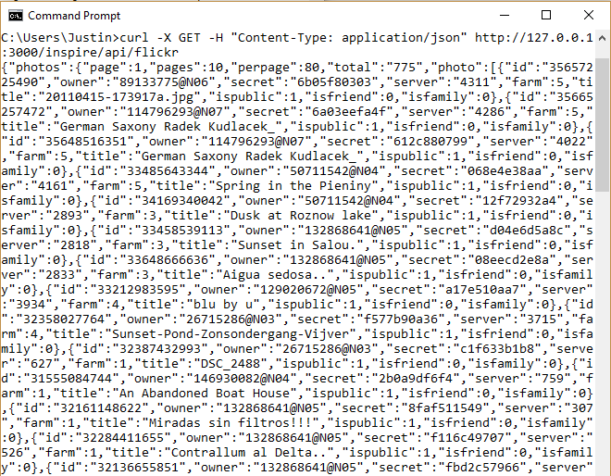
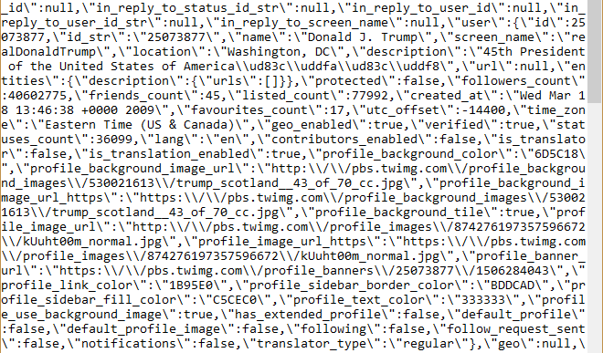
REStful APIs response
Twitter
Flickr

Slide 21
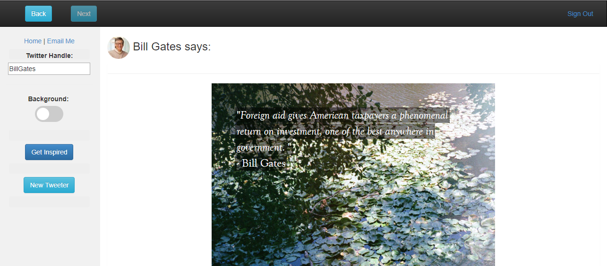
Questions?

